Slide 1

E Cigarettes 101

Slide 2

An e cigarette (vape pen) is a device that heats a liquid through a heated coil, creating a smoke that is inhaled similar to a cigarette. The effect is similar to that of an spray can.
CDC 2017/Beyond the Data/cdc.gov

Slide 3
What is in E-liquid?
The main ingredients include,
but are not limited to:
Vegetable Glycerin (VG)
Propylene Glycol (PG)
Distilled Water
Flavoring
Liquid Nicotine

Slide 4
Ingredient amounts and disclosure not required…
Levels of nicotine or any ingredient can vary from bottle to bottle, there’s no requirement to disclose amounts or ingredients on labels.
There’s no requirement to put an ingredient list on the label or even a label at all.

Slide 5
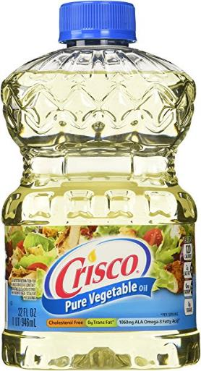
Vegetable Oil as an ingredient
Vegetable Glycerin VG is also an ingredient for e-liquids and is made up of vegetable oils.

Slide 6
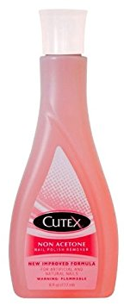
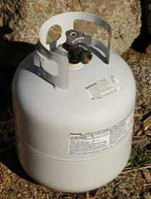
Propane as an ingredient
E liquid also can have Propylene Glycol (PG). Its purpose is to create the smoke effect. Another use for PG is known as propane, a highly flammable gas, commonly used to heat homes or a barbeque grill. PG is also used as acetone, the chemical used to remove nail polish.

Slide 7

Diacetyl is the butter flavoring in your popcorn and will digest in your stomach. This same ingredient however, is not safe when used as a flavoring ingredient in e liquid. When Diacetyl is absorbed by your lungs, the result of prolonged use is called “Popcorn Lung”, a deadly, incurable disease.
Flavoring
CDC 2017/Beyond the Data/cdc.gov

Slide 8

Popcorn lung

Slide 9
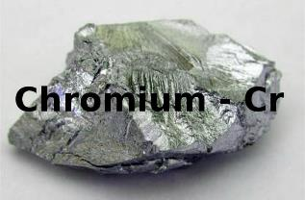
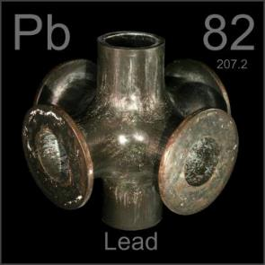
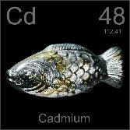
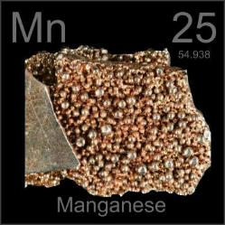
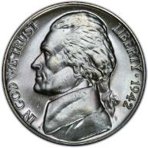
Heavy metals have also been found in e cigarette smoke as a result of e liquid exposure to the heated coil inside the e cigarette
CDC 2017/Beyond the Data/cdc.gov

Slide 10
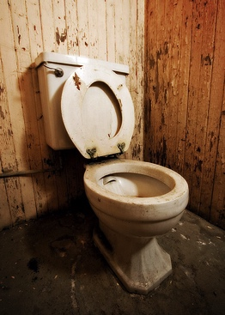
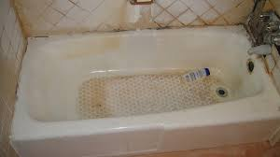
How is e-liquid mixed?
Any way the mixer wants to.
No regulations here either.
You don’t even have to wash your hands!

Slide 11
It is illegal in most states to purchase any nicotine product under the age of 18, unless your are in Hawaii. The legal age in Hawaii is 21.
Still, over 2 million youth in America are using e cigarettes.

Slide 12

What about advertising rules?
E cigarette companies do NOT have to follow rules that the cigarette companies do, therefore, advertising to children and teens is permitted.

Slide 13

Vapes in video games are permitted, note the “E” for everyone on the front cover.
CDC 2017/Beyond the Data/cdc.gov

Slide 14
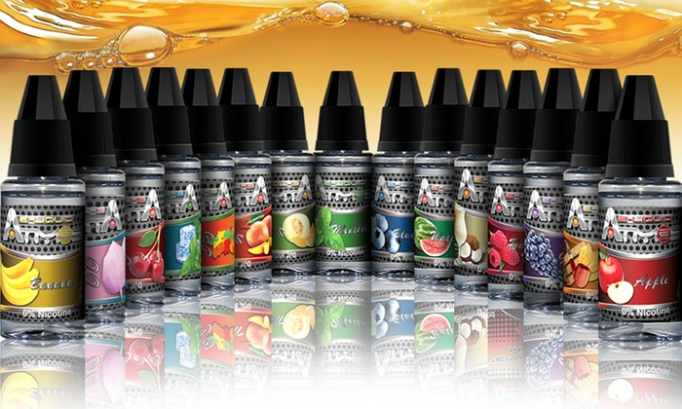
Restrictions on flavors?
NONE whatsoever.
Do you think a small child would be attracted to these?
CDC 2017/Beyond the Data/cdc.gov

Slide 15

Children in the ER Room
E liquid looks like a fruity juice to a toddler. E liquid poisonings in children have skyrocketed over the last few years.
CNN 2017/e cigarette poisonings/cnn.com

Slide 16

And of course the exploding e cigarette devices….

Slide 17
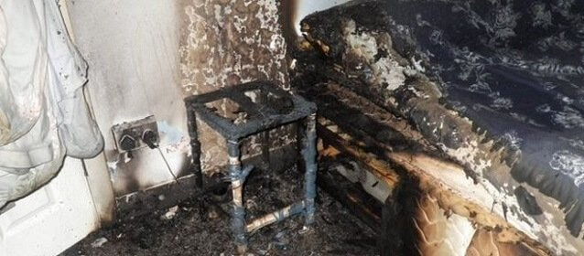
Common sense isn’t so common any more
There are NO laws requiring manufacturers to provide safety measures for these devices. Of course they are exploding.

Slide 18

Some words of wisdom …

Slide 19
Translation from Albert….
What Albert was trying to say is that “you are better than that”.
Never let anyone or anything make you feel like you are less than you really are.

Slide 20
Many thanks….
Arizona Attorney Generals Office
Gila County Health Department
STAND & Tobacco Free Environments
Glen Lineberry and the Miami High School
Jenna Shroyer, Governor’s Office of Youth, Faith and Family

Slide 21
Resources
Statistics and videos: CDC (Centers for Disease Control) www.cdc.gov
Coalition Information: STAND (Students Taking a New Direction) standaz.gov or contact: Ken Walker KWalker@thepartnership.us
Visit your local Health Department and ask them to direct you to their Tobacco Free Environments department or ask if they have a Prevention Team.

Slide 22

Brought to you by the Governor’s Office of Youth Faith and Family.

